Slide 1
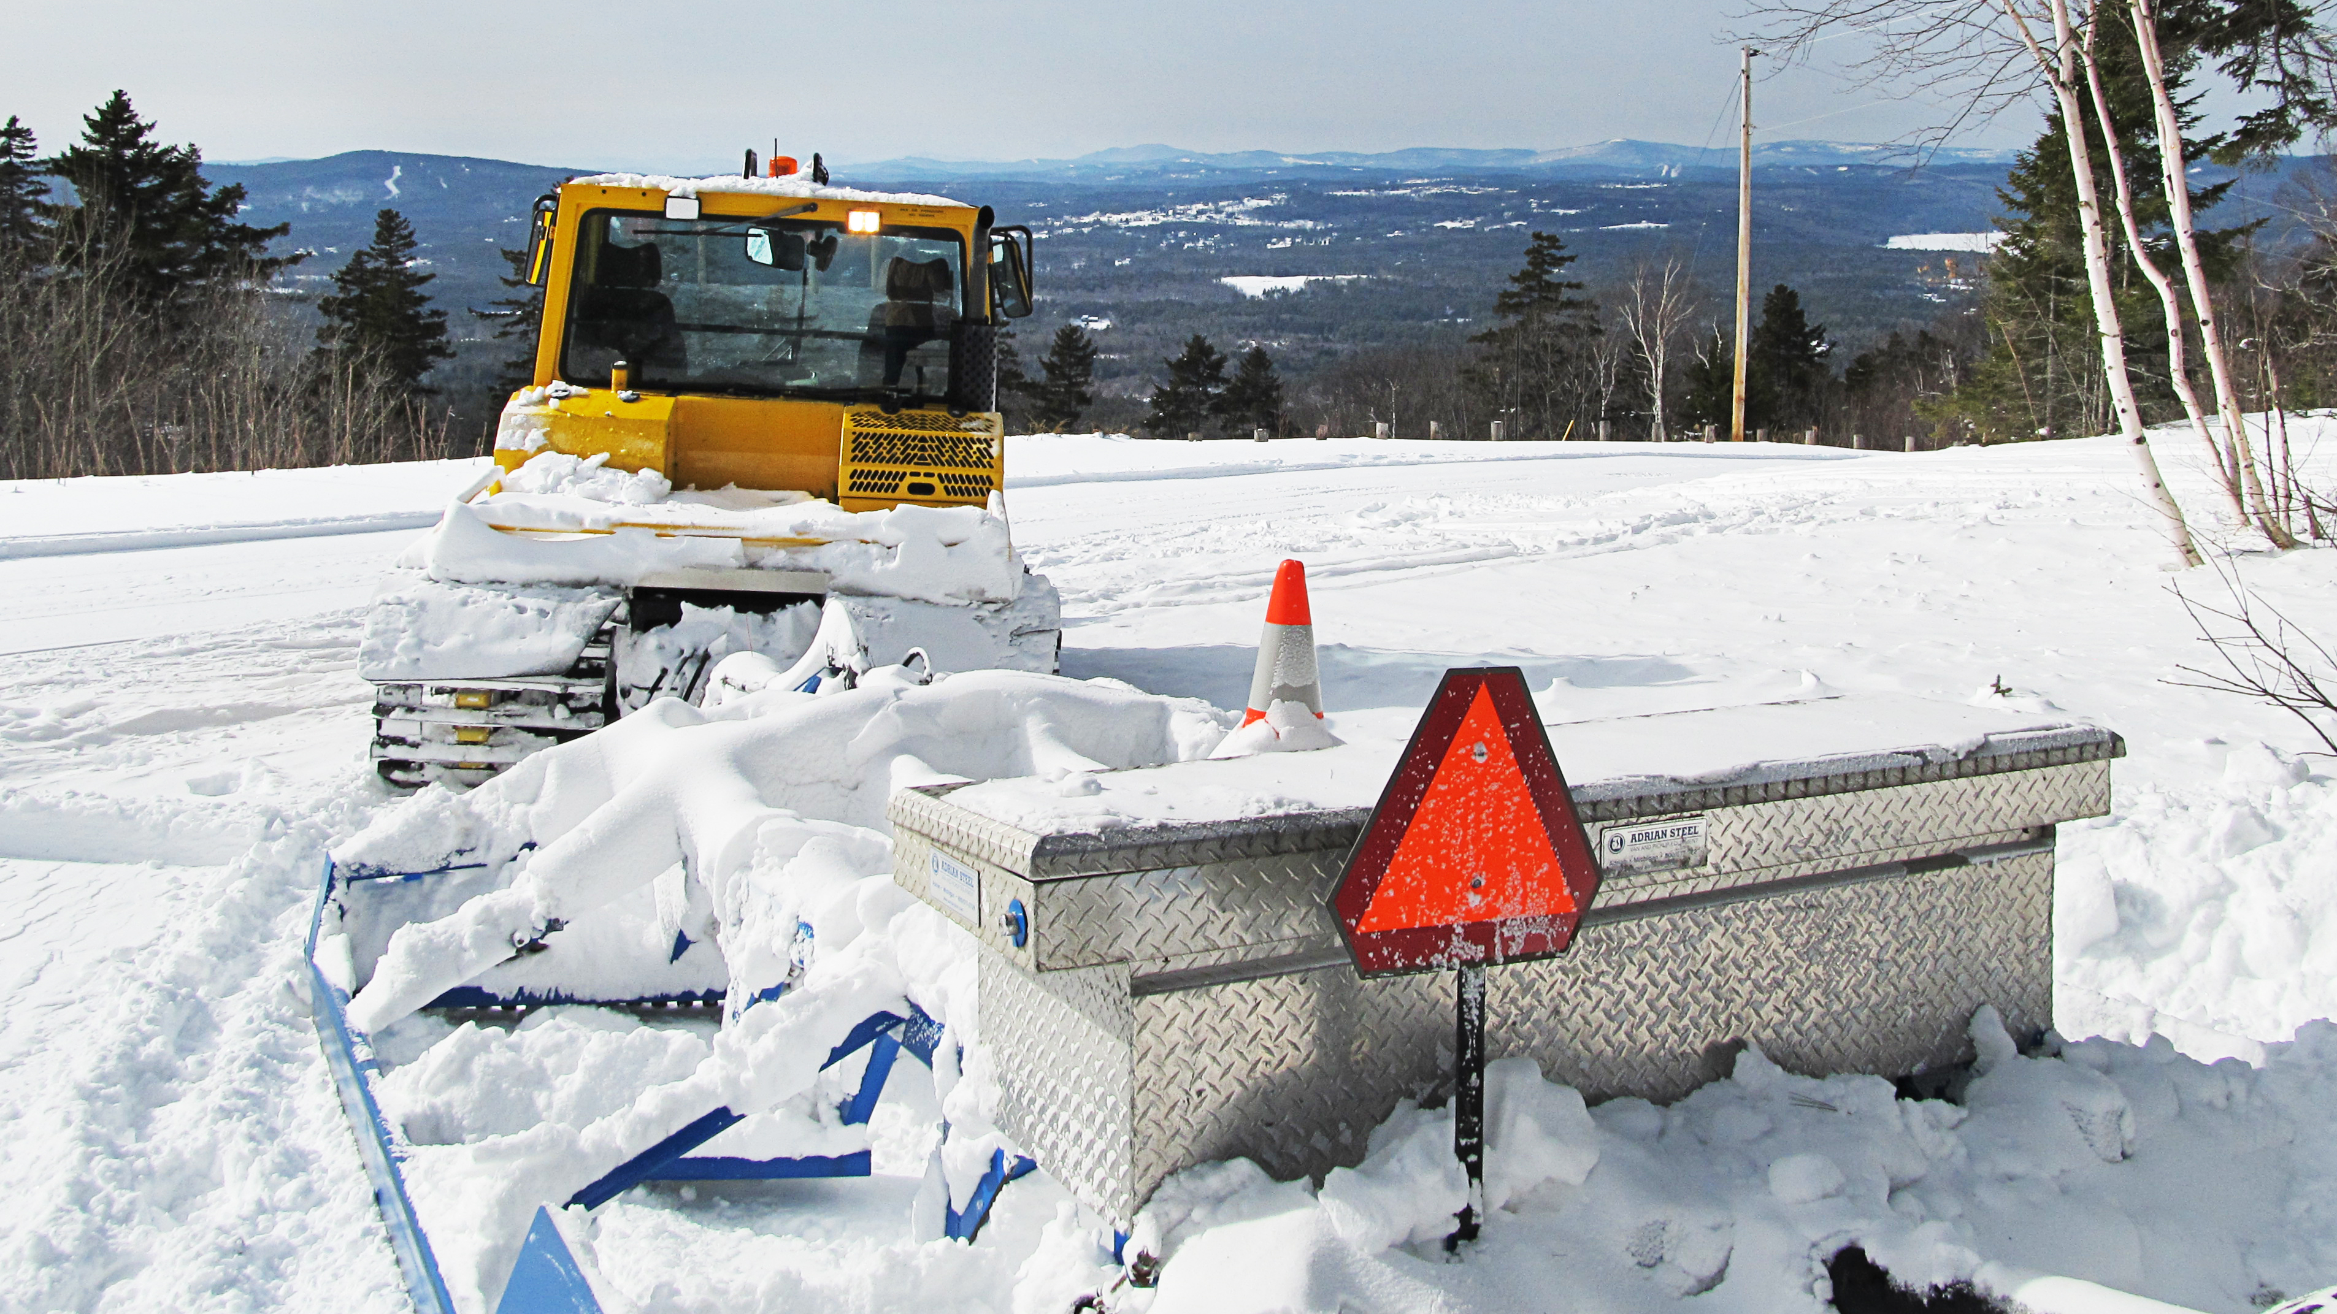

Slide 2
Registration Program Review Committee
New Hampshire Snowmobile Association Committee Members
Ev Ferrell, Kim Bergeron, Dennis Ford, Charlie Kurtz, Max Duncanson, Lisa Charrette, Rob Kennedy, Beth Palmer - ExOfficio, Chief Chris Gamache - BOT, Captain David Walsh - NHF&G, Dan Gould - Exec Dir, Terry Callum - Chair

Slide 3
Committee History
Clubs of Coos County asked NHSA to address funding shortfalls in spring of 2017.
NHSA Board of Directors voted to form a committee to study the entire program.
Committee formed in the early fall of 2017 and met for seven meetings, and had regular email conversations.
Last effort was in fall of 2008, which led to an increased registration price for the 2010/2011 winter season.

Slide 4
Issues Discussed
GIA budget of 50,000 registrations
Equipment prices going up: trade-in values are flat or going down
Current funding would only buy a couple of groomers per year
Vintage, Dealer and Rental registrations
Fines related to off trail, modified exhaust, and un-registered.
Marketing of our program
RTP Program and other funding, incentives

Slide 5
Program Analysis

Slide 6
Program Analysis Initial Views
Built ad campaign for Sno-Traveler: Registration is your best accessory.
Despite moratorium program can only afford a few machines per year. Class 3 and higher will require 62½ years to replace.
2010/2011 was over 50k and despite a registration increase – was higher than previous season.
Since 2012 we have not reached 50k registrations.

Slide 7
Program Analysis Other Funding
VW Settlement (BOT may use), but requires destruction of engine block – think cash for clunkers. Likely not a good club path.
Gas Tax – We are already receiving a significant amount of un-refunded gas tax for non-road use into the registration program
Rooms/Meals – We would not only have to fight for the dollars, but we would have to continually fight to keep them.

Slide 8
Program Analysis Funding
RTP Program – Move $160-180k from motorized to fund winter grooming. VAST has done it, too. Would allow $160-180k to shift towards other grooming or summer projects. NHSA Board voted to do this. RTP for clubs will be available for diversified projects (multi-use)
Early Bird/Incentives = Club Membership Registration Discount is our program. Difficult to do both.
Through all discussions user fees remain the most stable and defendable sources of revenue. It’s our money...

Slide 9
Program Analysis Vintage - Dealer - Rental
Vintage Registrations – concerns were raised about the late 90's and into the 2000's. Will a permanent plate with a one time cost be appropriate for them? Also, discussed was that non-residents couldn't participate, so some clubs are pulling event permits to hold vintage rides.
Dealer and Rental registrations are exceptionally inexpensive – with rental units having higher trail usage and law enforcement implications.

Slide 10
Program Analysis Fines
Illegal off-trail – Currently less than $75 – often considered highly inexpensive by those violating.
Unregistered – Currently less than $125, those riding without a sticker don't think it is a very high cost.
Modified Exhaust – Currently less than $75 – again considered inexpensive for those violating.
Above violations can lead to loss of trails and higher program costs

Slide 11
Program Analysis New York State Model
Committee discussed NYS model for funding grooming operations
Double, to nearly double, the grooming rate
Stop GIA equipment purchases – and collapse equipment dedicated fund into grooming operations and summer construction
Change our classification of machines to echo NYS (reducing classes)
NH spends $1.2 to 1.6 million on operations – approximately $3 million would be needed

Slide 12
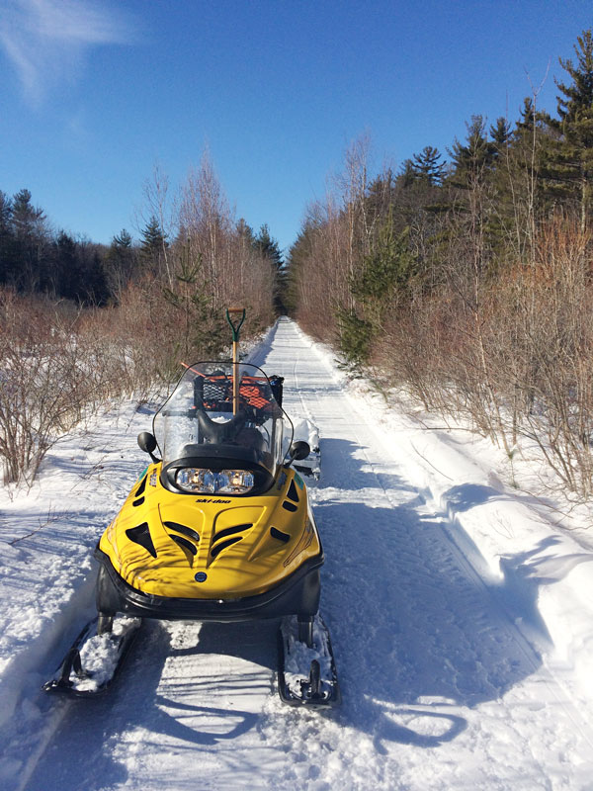
Strengths and Advantages

Slide 13
Strengths and Advantages
Clubs would receive more in line with what it costs to own/run their equipment.
Once all liens are removed, clubs would be free to buy/sell/trade when appropriate for them, not when a grant can be received.
Clubs would be incentivized to both operate when snow conditions allow, but also to maintain/service their equipment. No refurbishing or replacement grants will be received.

Slide 14
Strengths and Advantages Cont.
Bureau of Trails would no longer maintain liens or make equipment decisions.
Market conditions would change – dealers will know a club's level of seriousness, clubs can purchase other club's equipment without waiting for grant decisions.
Clubs may right-size their fleet and likely partner with their neighbors to groom.
Next page is a sample of what we'd like to see for equipment rates.

Slide 15
Sample Rates by Class
Equipment classes changed/condensed
A | Standard snowmobile, Alpine, and other small twin tracks, Polaris WT/LT, WT Bearcat, Skandic WT/ SWT, Tracked ATV/UTV | $32.00
B | 50-80 horsepower | $55.00
C | 81-150 horsepower | $80.00
D1 | 151 or more horsepower with an 8 or 9’ drag | $100.00
D2 | 151 or more horsepower with a 10’ drag | $113.00

Slide 16
NYS Model Challenges
New Model = Clubs that consistently groom benefit the most by this program.
Current Program = Clubs that consistently groom receive more dollars but also spend more of their own to do it!
New Model = Clubs won't have equipment grants and think they won't be able to buy a machine any time soon.
Current Program = Wait a lot of years and pay 40% of what machines cost then!

Slide 17
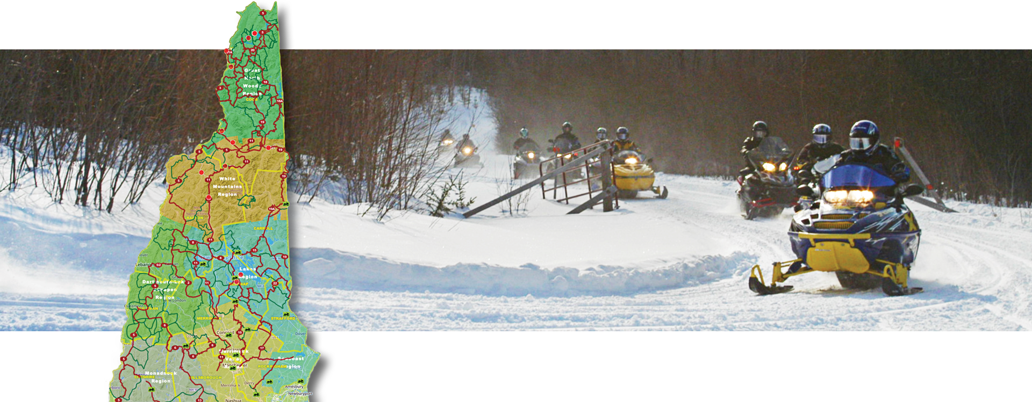
Next Steps of Action

Slide 18
Next Steps of Action
Resident and non-resident registrations would need to be $150 and $160. After club discount this would be $120 and $130 per sled. Maybe a $10 increase at 24 months.
Goal is that clubs/GIA would get a higher percentage in the breakout. Agencies will have a lower percentage vs. the total.
Vintage lifts to current pricing (keeping it in sync going forward). Allow non-residents to buy. Stop selling for machines after 25 years back from passage. Maybe nothing after 1995?

Slide 19
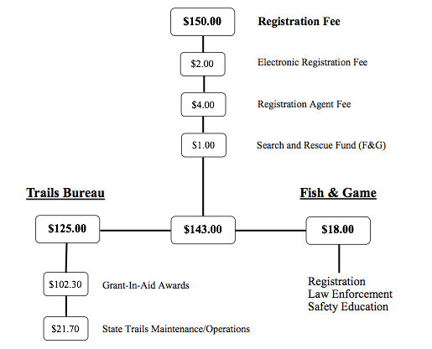
NH Resident
Non-Club Member
Proposed Allocation of
Registration Monies

Slide 20
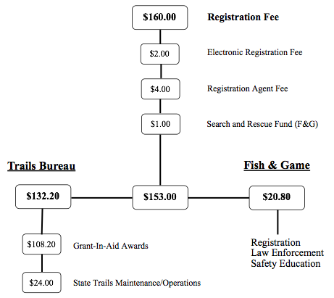
Non-NH Resident
Non-Club Member
Proposed Allocation of
Registration Monies

Slide 21
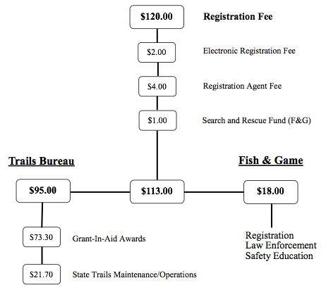
NH Resident
Club Member
Proposed Allocation of
Registration Monies

Slide 22
Non-NH Resident
Club Member
Proposed Allocation of
Registration Monies

Slide 23
Next Steps of Action - continued
Budget should be based on 40k registrations
Rental and Dealer registrations also increase. R = $250 ($150 GIA, $50 BOT, $50 F&G) and D = $100 ($50, $25, $25).
Fines = Legislation and rule changes - $250 for each item we've considered.
Legislation to force rule changes for rates, and end all equipment liens 3 years out.
NHSA Board would have to vote to pursue legislation. Current estimates are $30k will be needed to get it across the finish line.

Slide 24
Conclusion
Our last increase was considered 10 years ago. It took time to legislate - this change will too.
A modest increase wouldn't allow for this program change nor will the equipment fund reach an updated fleet.
Fines need to be appropriate!
NHSA doesn't benefit from this effort financially. Stronger Clubs = A Stronger Association!

